Slide 1
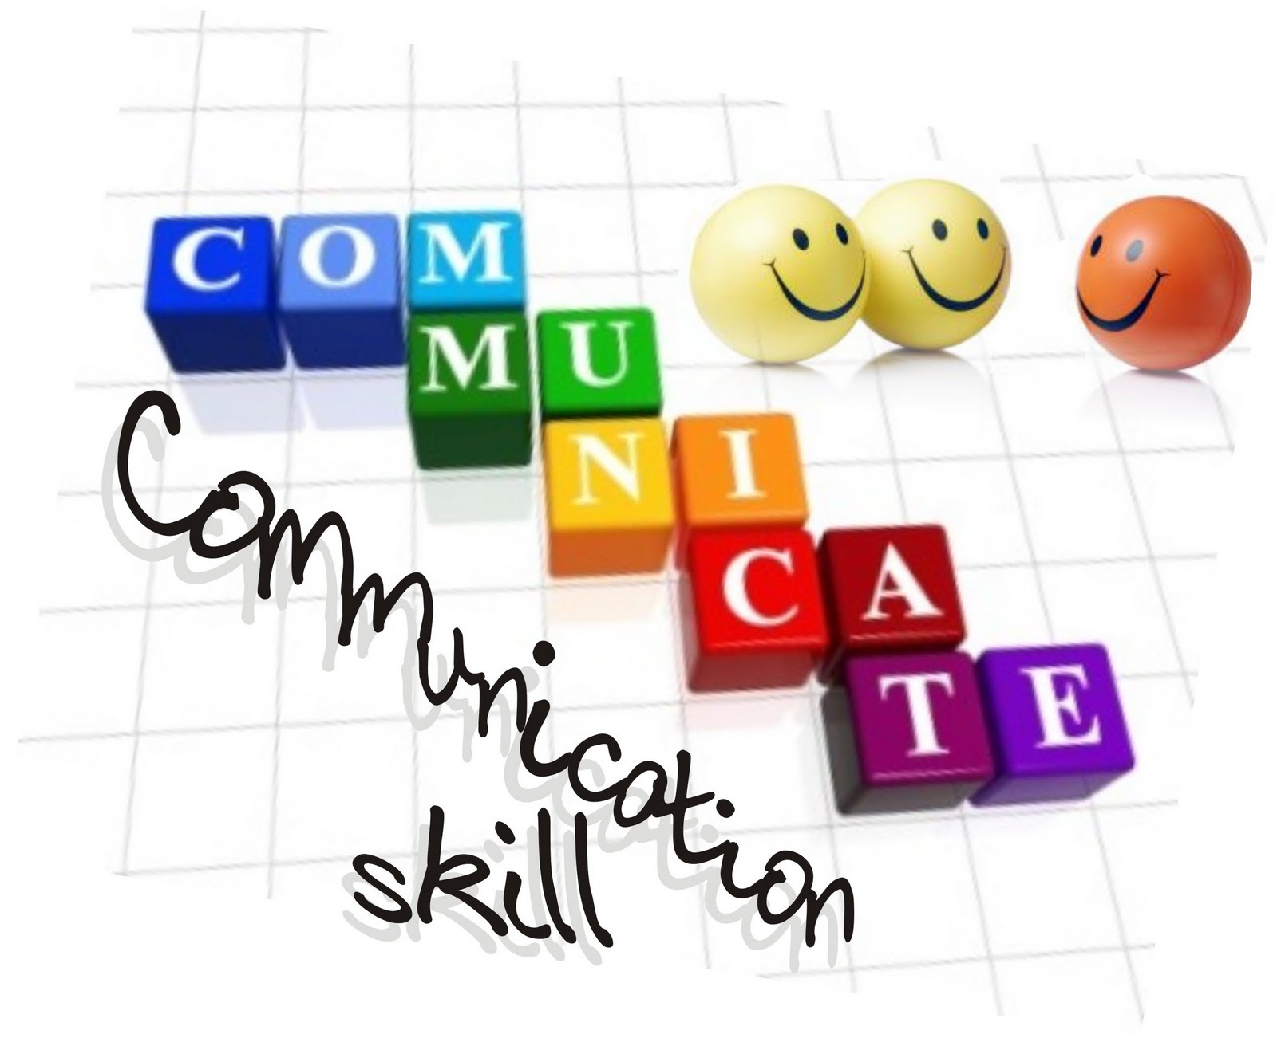
G.K.BHARAD INSTITUTE OF ENGINEERING
BASICS OF COMMUNICATION
DIVISION-C.E
Roll No-21
Prepared By-
Akabari Viral M.
Guided By-Rahul Sir Chanu

Slide 2
Contains:
Definition Communication Skills
Process Of Communication
Types Of Communication

Slide 3
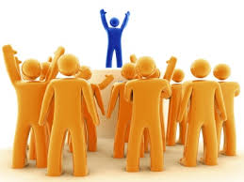
Definition Communication Skills
“Communication is the activity or the process of expressing ideas and feelings or giving people information”.
…(OALD)
Basically the word ‘communication’ is derived form Latin origin word ‘communes’
Which means common or general communication means sharing our ideas, feelings, information opinions etc.

Slide 4
What is a Communication ?
Basically, the word ‘ Communication ’ is derived from latin origin word ‘ communis ’ which means common or general.
It means sharing – sharing of ideas, feeling , joy or information.
In other word, it may be defined as giving, receving or exchanging information/ opinions or ideas by writing, speaking or visual means, so that the message communicated is completely understood by every one concerned with it.

Slide 5
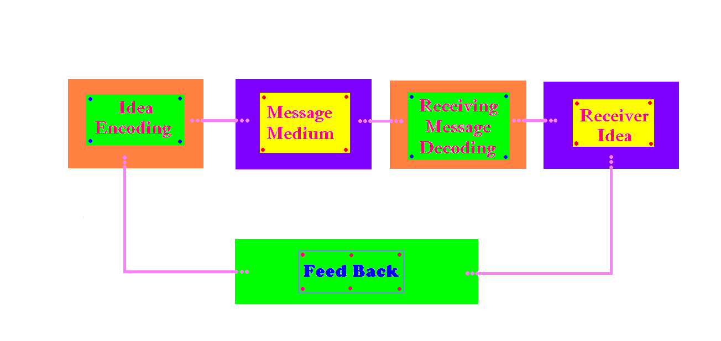
Process Of Communication

Slide 6
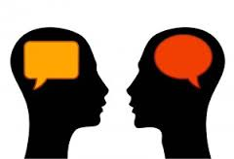
Ideas
For communication we have to transfer ideas and thought from our mind to the mind of other person to transfer an idea.
We must use symbols like words, signature, picture, sound etc.
Which is know as idea

Slide 7
Sender
The generator of the idea is considered as the sender. The sender try to evaluate this thoughts or the ideas and attempts shape in the form of commonly accepted language.

Slide 8
Encoding
The process of coding the ideas into commonly accepted human language Is know as encoding.
Ex- the working of the message may be different fore different methods of communication to be used.

Slide 9
Message
The encoded idea is called as message. A message can be same information ideas, filling, events….etc.

Slide 10
Medium
The sender select and appropriate medium for success full transmission of the message
If the sender doesn't select the transmission mode correctly may be many changes or miss communication proper care should be taken will choosing the channel.
The message received the receiver without any disturbance.

Slide 11
Noise
In the process of transmission of message varies distortion can block the smooth flow of message.
This distortion are know as noise.

Slide 12
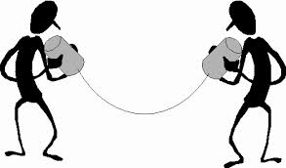
Receiver
The receivent of the message is called the receiver.
function are attending to the message inter prating and evaluating the message.

Slide 13
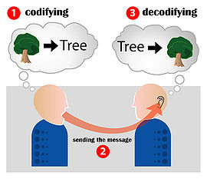
Decoding
The process of explaining of the message is called decoding.

Slide 14
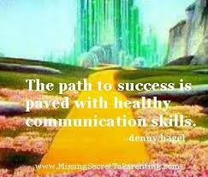
Feed back
The response or return message is called feed back.
When the feed back is gate by the sender the cycle is complete.

Slide 15
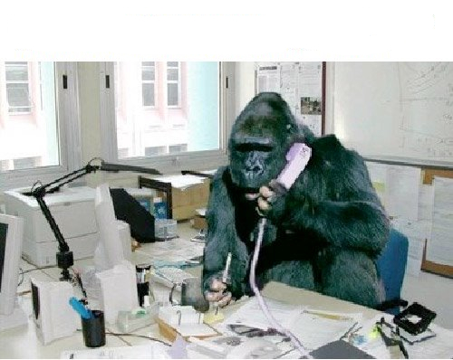
Types Of Communication
Verbal communication
Nonverbal communication

Slide 16
Non verbal communication
Kinesis
Chronemics
Proxemics
Paralinguistic
Appearance

Slide 17
Kinesis
Kinesis is the name given to the study of the body's physical movement. In other words it is the way, the body communicates without words.
Ex- nodding your head, blinking your eyes, shrugging shoulder, smile…etc

Slide 18
Chronemics
Chronemics is related to our use of time.
Silence play a significant role in communication.
Silence is considered as a language of many emotions , how do you communicate with others.

Slide 19
Proxemics
Proxemics word is derived from ‘proximity’ which means nearness and proxemics means distance.
Edward T. Hall divide space into four distinct zones.

Slide 20
1) Intimate distance
This zone starts with personal touch and extends just 18 inches (1.5 feet).
Ex. :- member of family , relatives , husband and wife , lovers and parents under this zone.

Slide 21
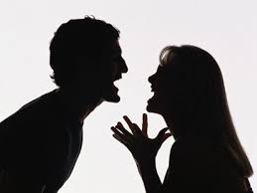
2) Personal distance
This zone extends 18 inches to 4 feet.
Ex. :- your close friends , colleguege , peers.

Slide 22
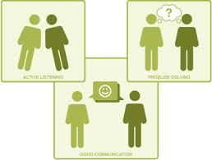
3) Social distance
This zone extends 4 feet to 12 feet.
In this zone relationships are more official.

Slide 23
4) Public distance
This zone starts from 12 feet to 30 feet or to the range of eye sight.
Ex. :- the prime minister of a country have to maintain this distance or security reasons.

Slide 24
Paralinguistic
Paralinguistic deals with vocal qualities as volume , pitch , rate , pronunciation and intonation patterns.
Therefore you may find it useful to understand the characteristics of voice.

